Slide 1
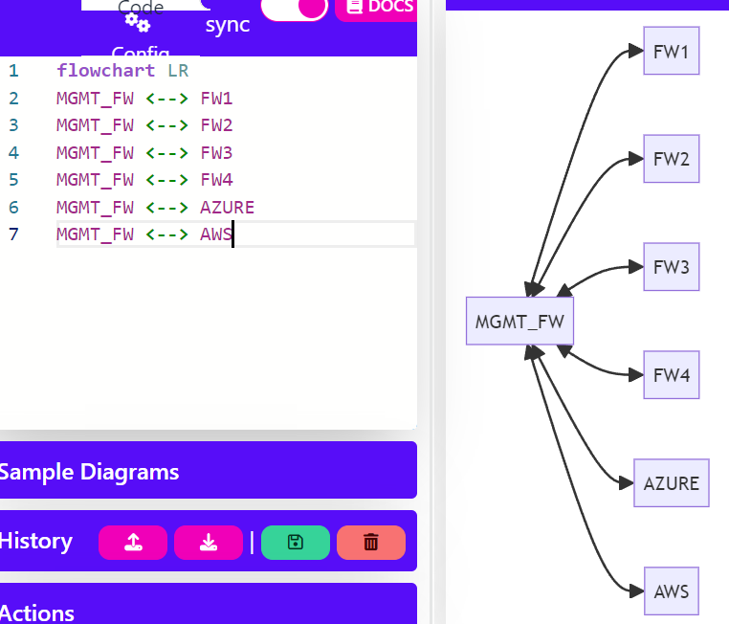
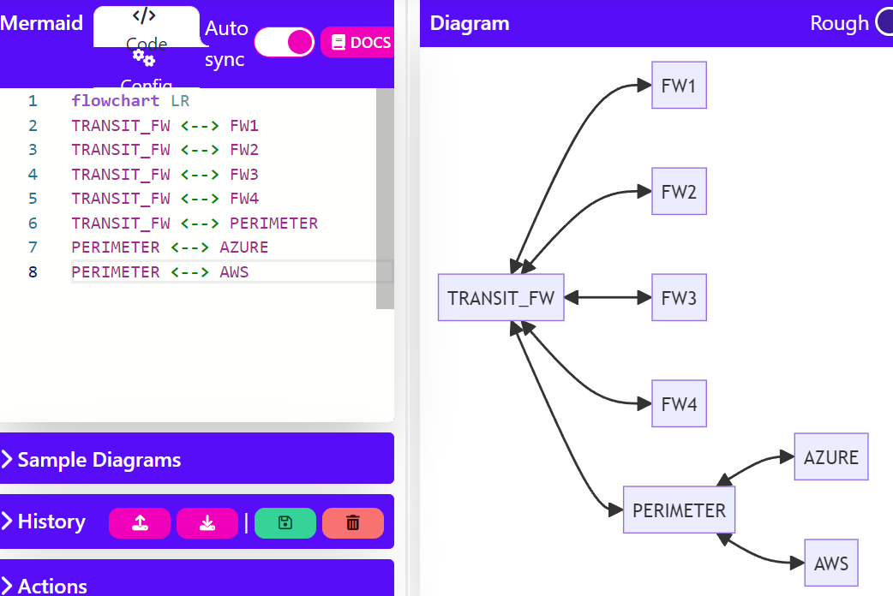
Define Topologies

Slide 2
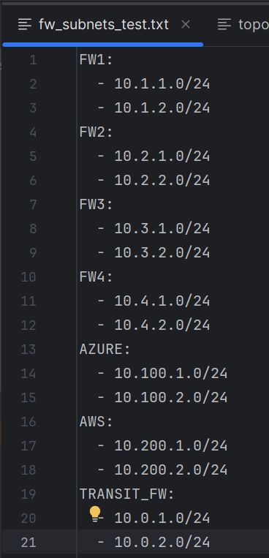
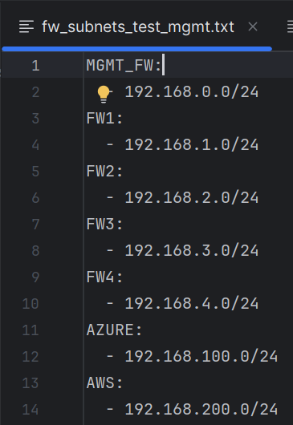
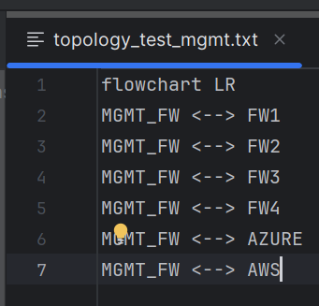
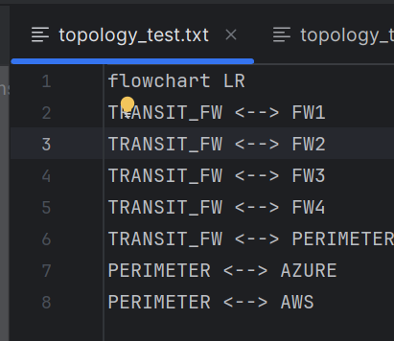
Save Topologies and Define Subnets

Slide 3
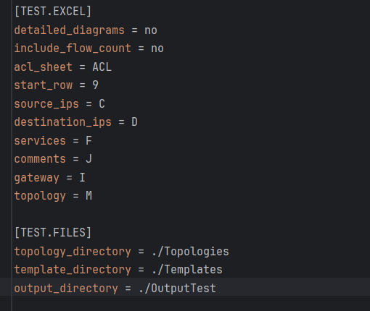
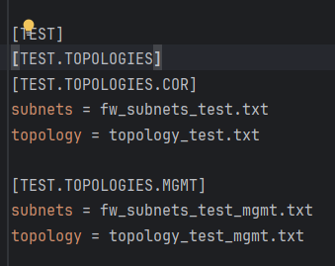
Config.ini file

Slide 4
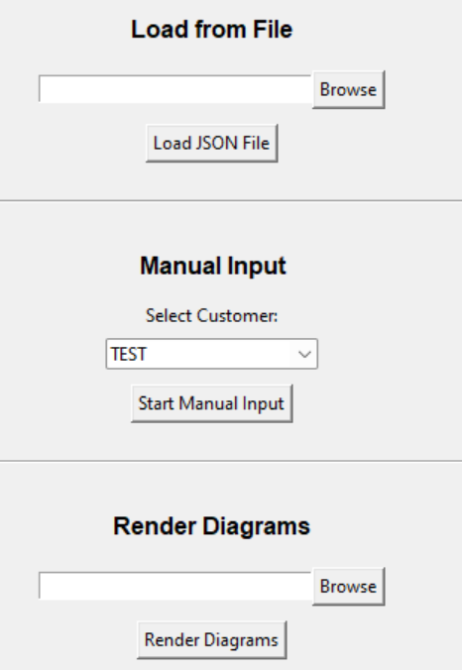
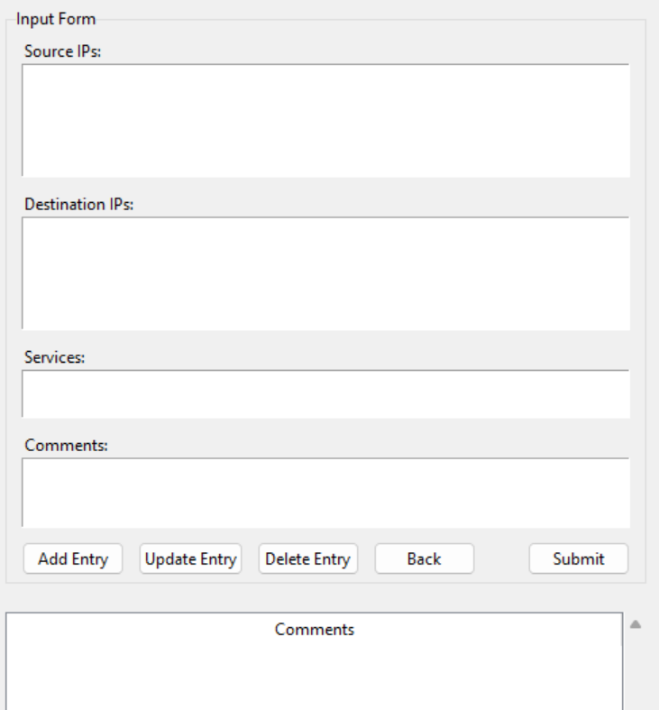
Select Customer to Start Manual Input

Slide 5
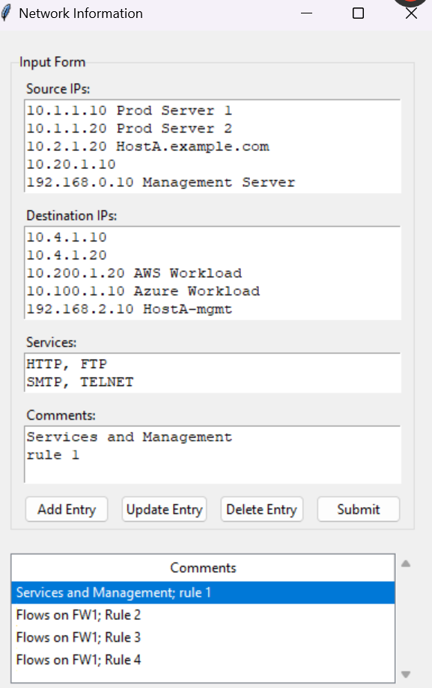
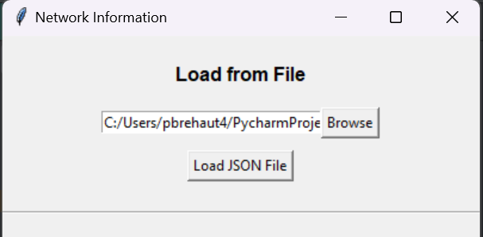
Load from save file
Every time you submit the original content you entered will be saved in json to allow you to edit this directly or reloaded back into the GUI

Slide 6
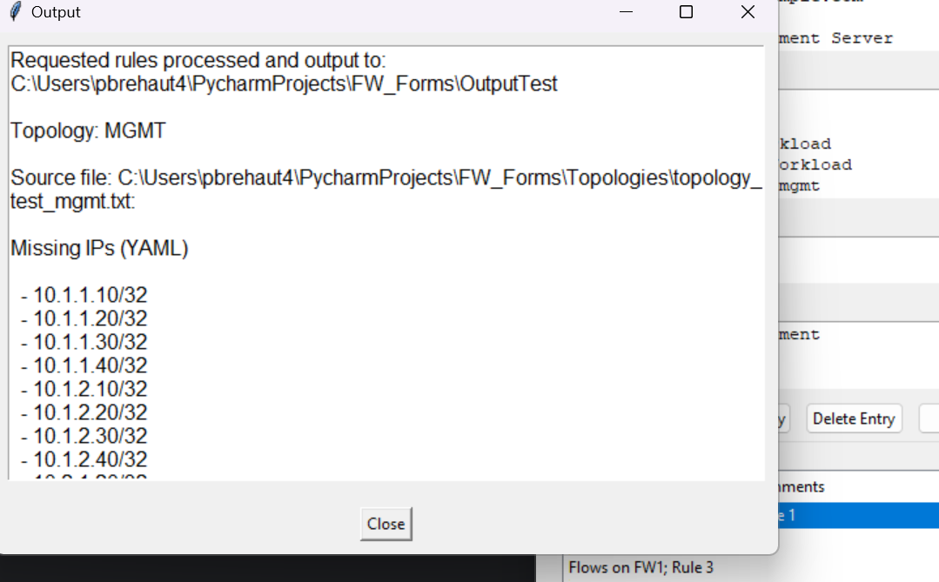
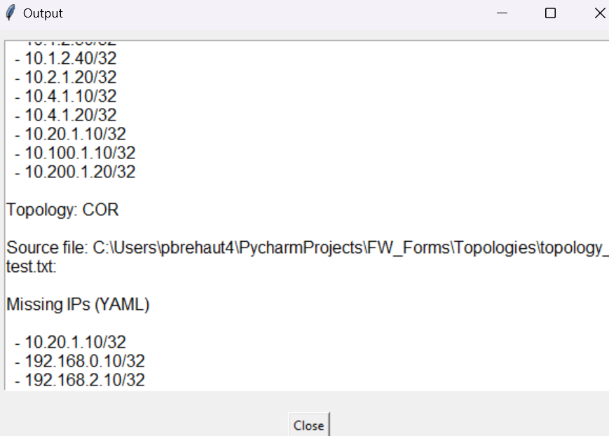
After submitting and the form is generated a list of IPs that are not matched to your topology will be outputted, these may need attention to complete the firewall request properly. In this case the IP's are not matched to the alternate topology so there is no action required here

Slide 7
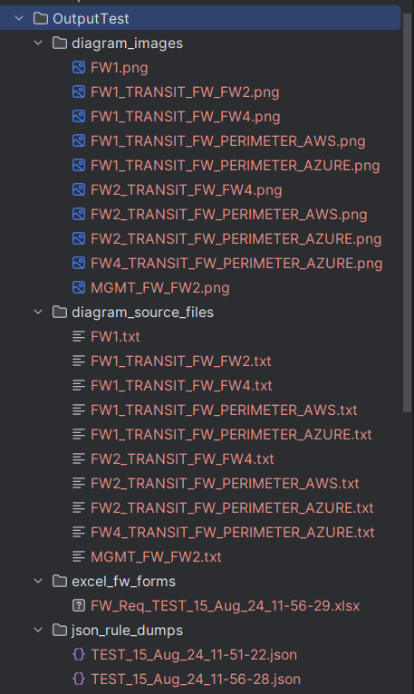
Files are outputted -Diagram images -diagram source files to allow the user to edit them -the original request submitted saved in json to allow the user to reload this later -the XL form which will either be based on a template or just a plain new XL form this

Slide 8
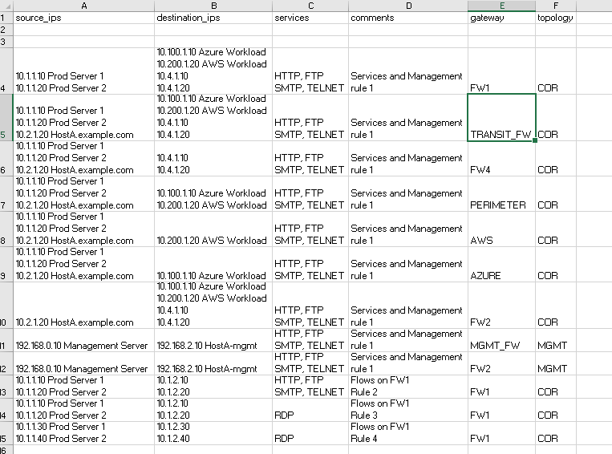
Sample output showing the rules split up based on the firewalls that need to be installed on

Slide 9
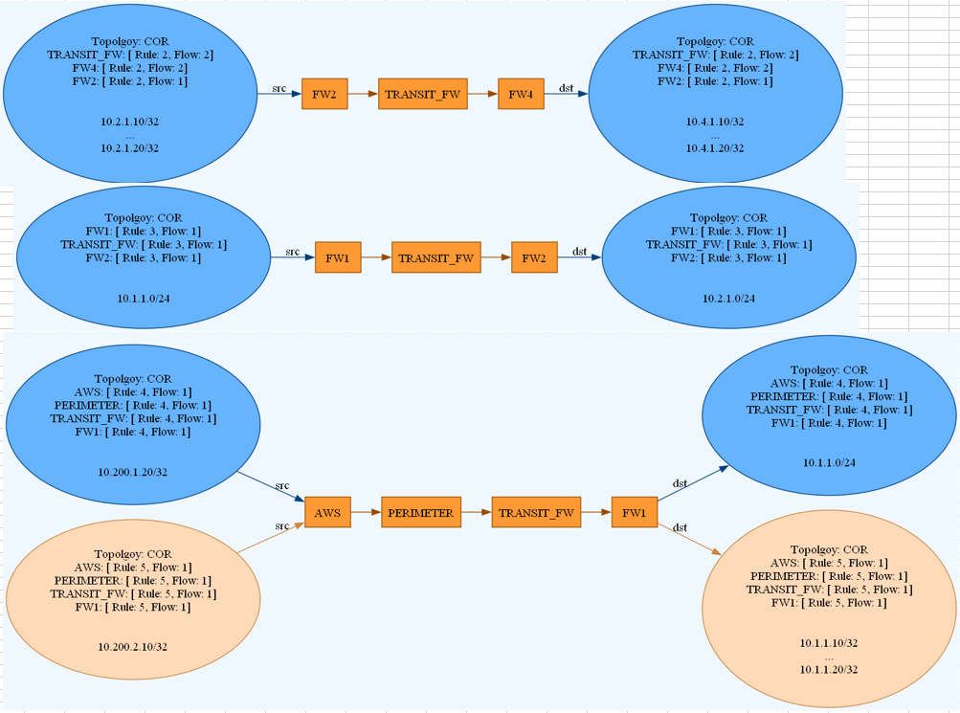
Diagrams are inserted in the diagrams worksheet. The format will depend on the option specified in the config.ini file The text on the source and destination endpoints provides detail to map this back to an item in the firewall request

Slide 10
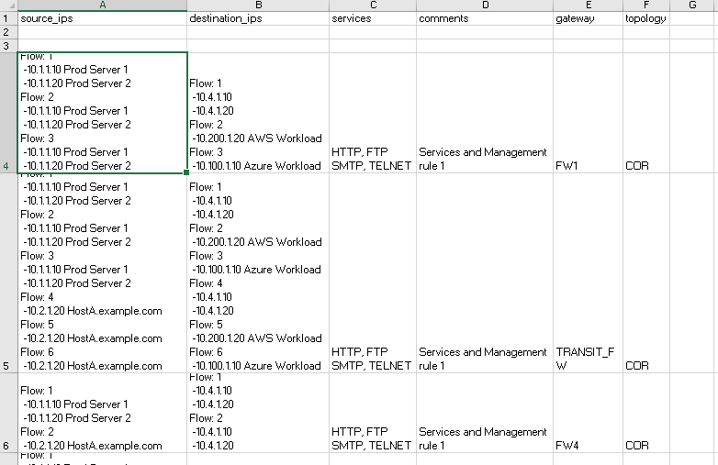
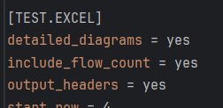
If you specify include_flow_count the request will put a flow label for all the source destination flow permutations that are grouped together in the same row to be installed on the same gateway
The config.ini File will be re-read each time you click submit so there is no need to reload the app after making changes

Slide 11
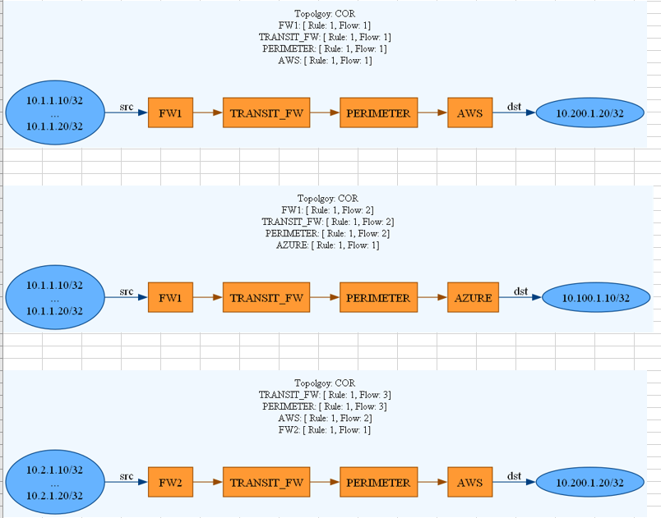
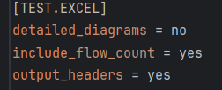
If you specify no for details_diagrams it will group all the flows together for each path for the rule set requested

Slide 12
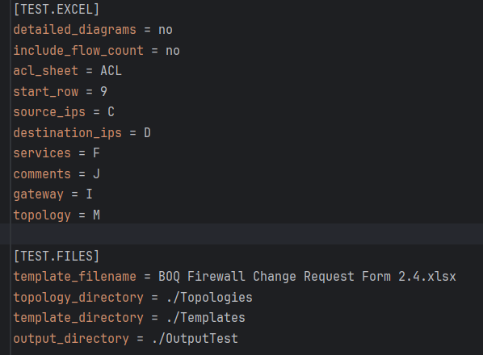
If you want to populate a template specify the template file and configure which columns you want to use, what starting row, and what worksheet it should be outputted to

Slide 13
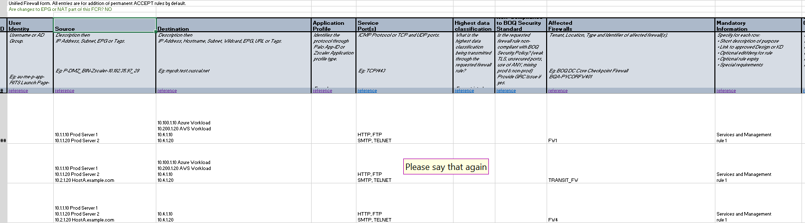
A copy of the template will be made and populated with your request and diagrams

Slide 14
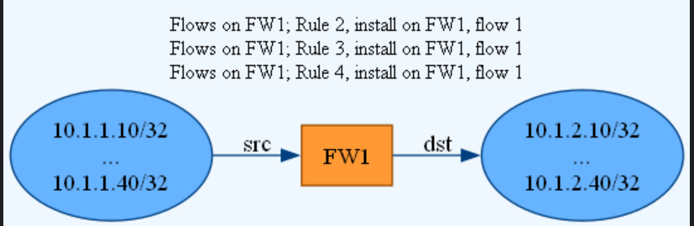
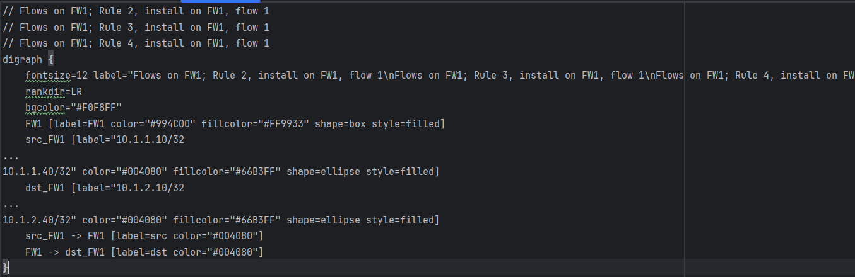
Customised diagrams - Original diagrams and source file

Slide 15
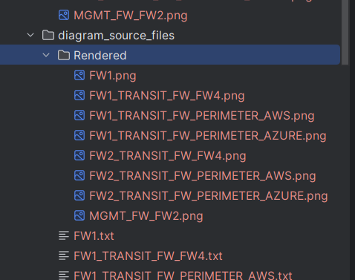
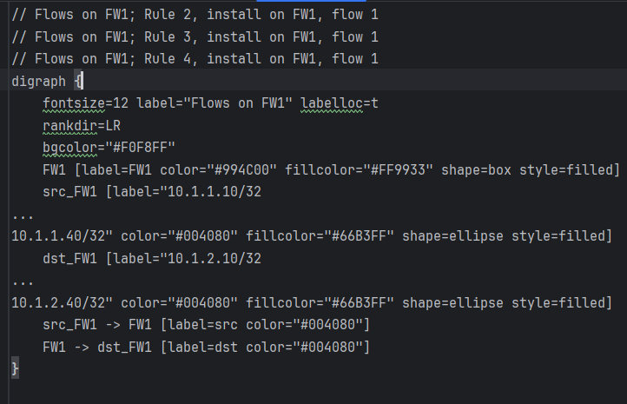
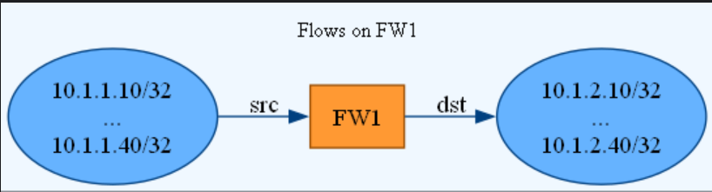
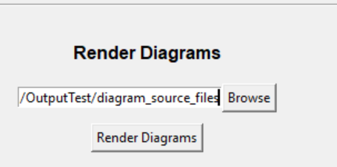
Modified source file and re-rendered image

Slide 16
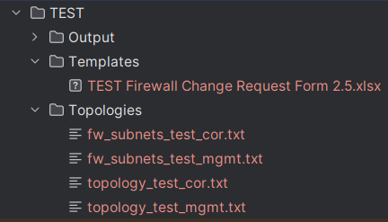
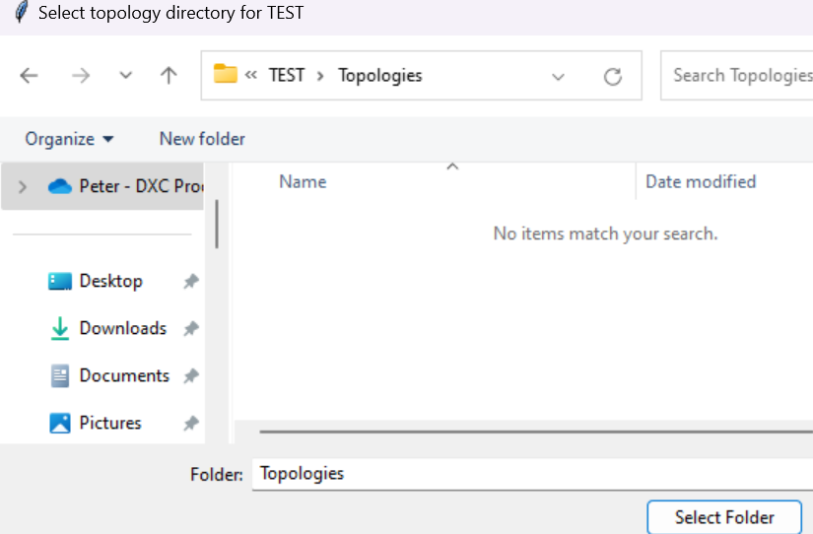
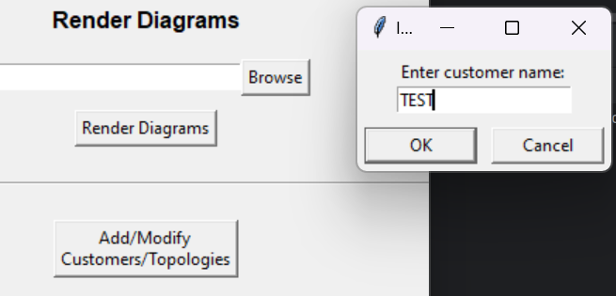
Add new customer: Select the directories for topologies, templates and output

Slide 17
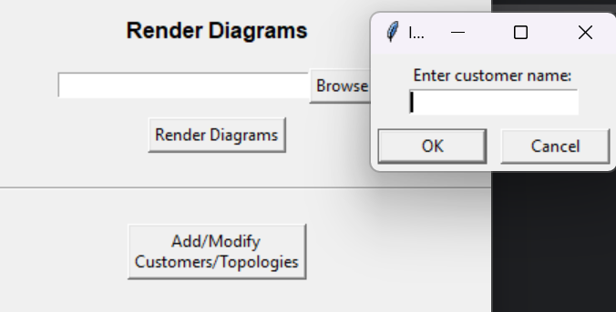
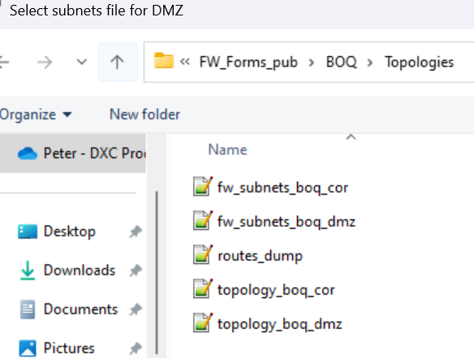
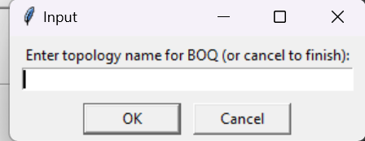
Setup via GUI – Add Topology for existing customer

Slide 18
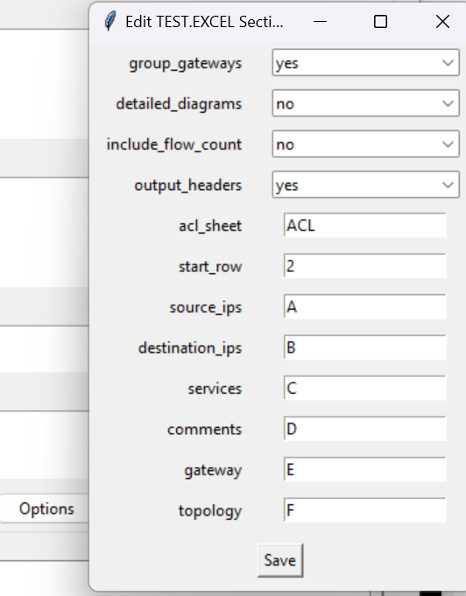

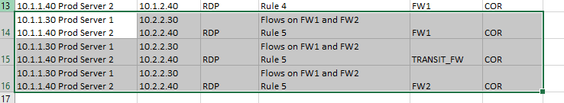
Excel Options
Group_gateways = yes
Group_gateways = no

